Slide 1
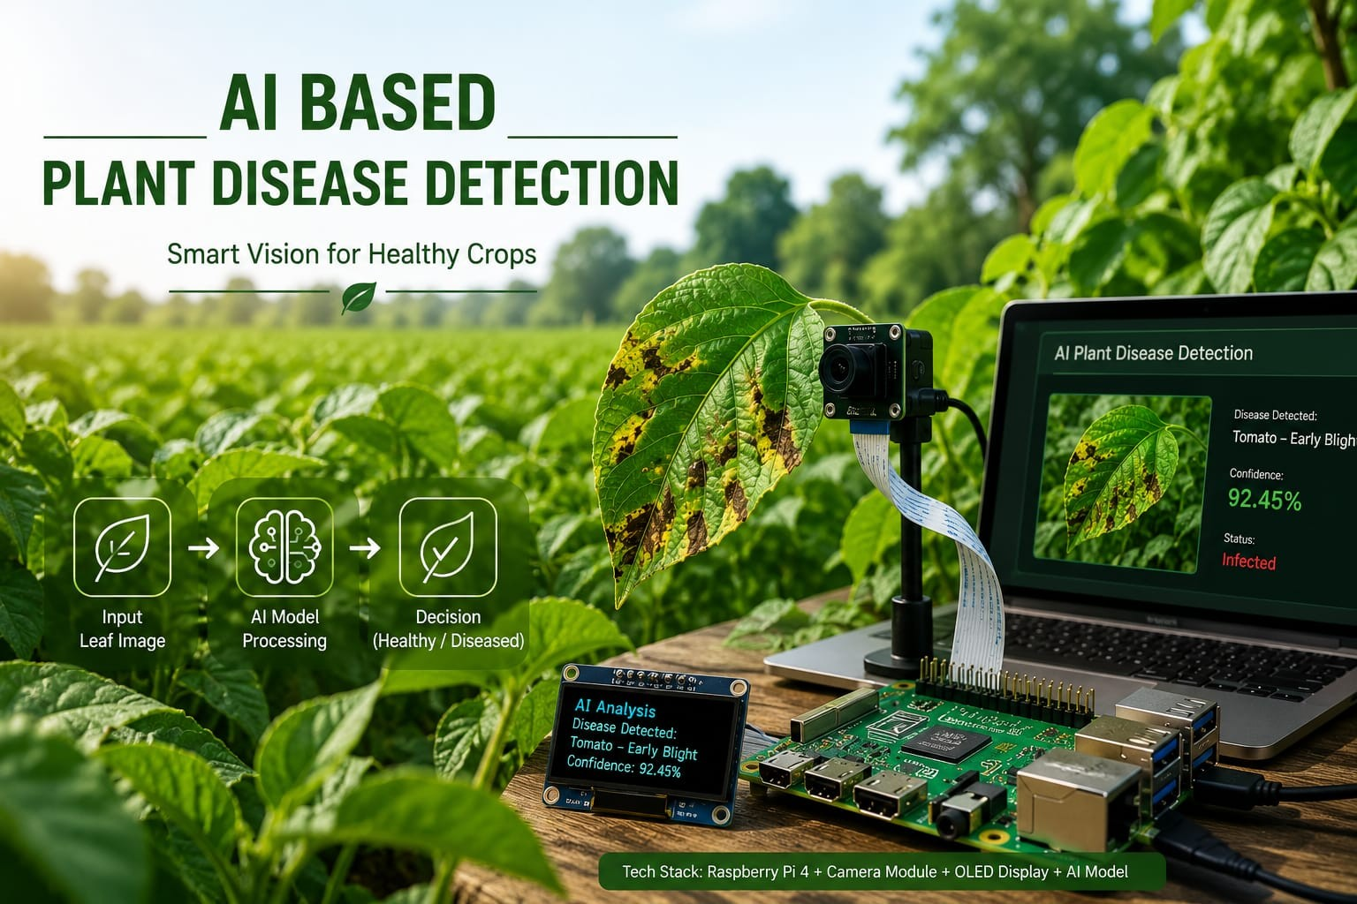
Presented by:
D S DAVANA
SRUSTI M S
TEJASWHI K Y
VEERESH N ACHAR

Slide 2
Introduction
Agriculture is essential for food production, but plant diseases reduce crop yield and quality. Manual disease identification is time-consuming and requires expert knowledge.
This project uses Artificial Intelligence (AI), TensorFlow Lite, Raspberry Pi, a camera, and an OLED display to detect plant diseases quickly and accurately through live camera images or uploaded images.
Benefits
• Smart Agriculture
• Early Disease Detection
• Higher Crop Yield
• Easy to Use
• Saves Time and Effort

Slide 3
Problem Statement
Traditional plant disease detection has several limitations:
• Requires expert inspection
• Time-consuming process
• Delay in disease identification
• Reduced crop productivity
• Difficult for farmers to detect diseases early
Solution
AI-based plant disease detection

Slide 4
Objectives
• Develop an AI-based plant disease detection system.
• Detect diseases using a Raspberry Pi Camera.
• Allow users to upload plant images for analysis.
• Display disease name with confidence score.
• Show detected disease on an OLED display.
• Provide a simple web interface for farmers.

Slide 5
Hardware and Software Used
Hardware
• Raspberry Pi 4 model B
• Pi Camera Module
• OLED Display
Software
• Python
• TensorFlow Lite
• OpenCV
• Flask, HTML, CSS

Slide 6
Methodology
Capture leaf image using live camera or upload image.
Resize and preprocess the image.
Feed image into the TensorFlow Lite model.
Predict disease class.
Display disease name and confidence.
Show disease name on OLED display.
Display result on the web application.

Slide 7
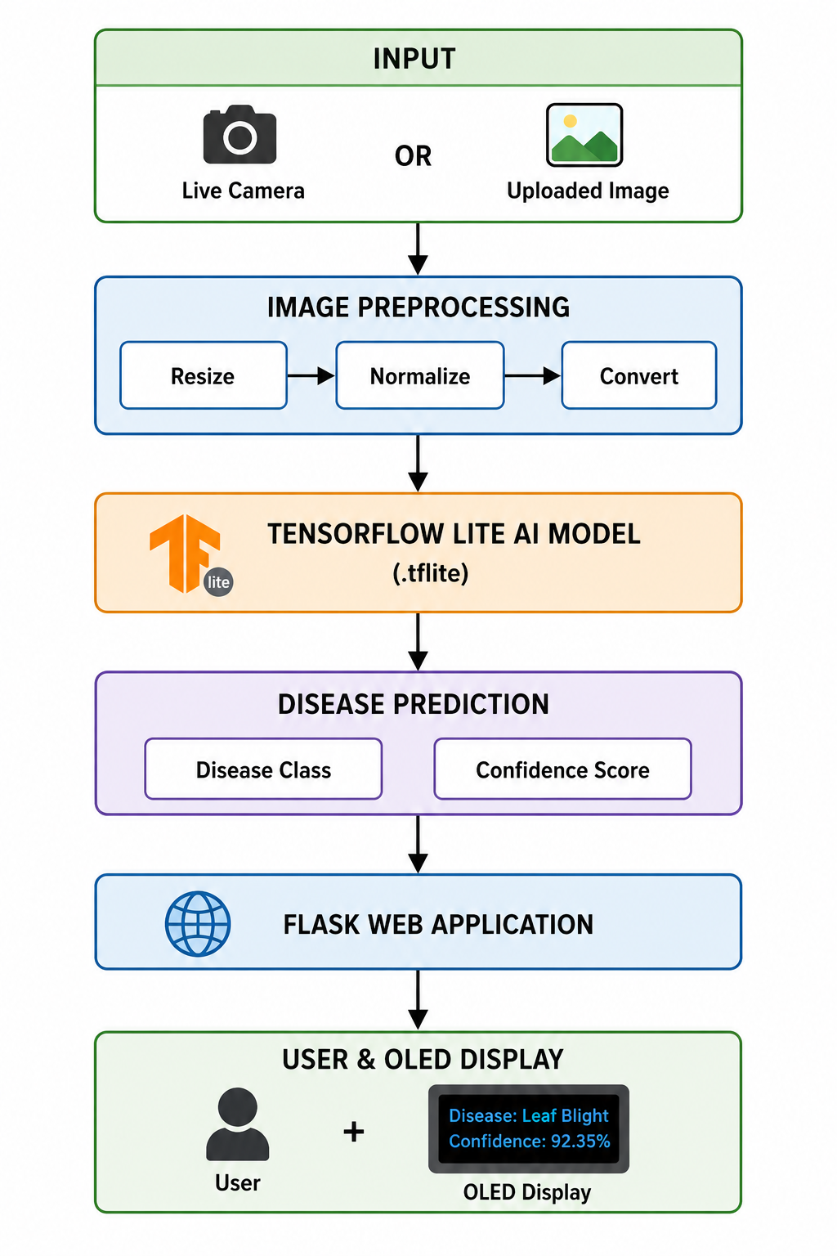
System Architecture

Slide 8
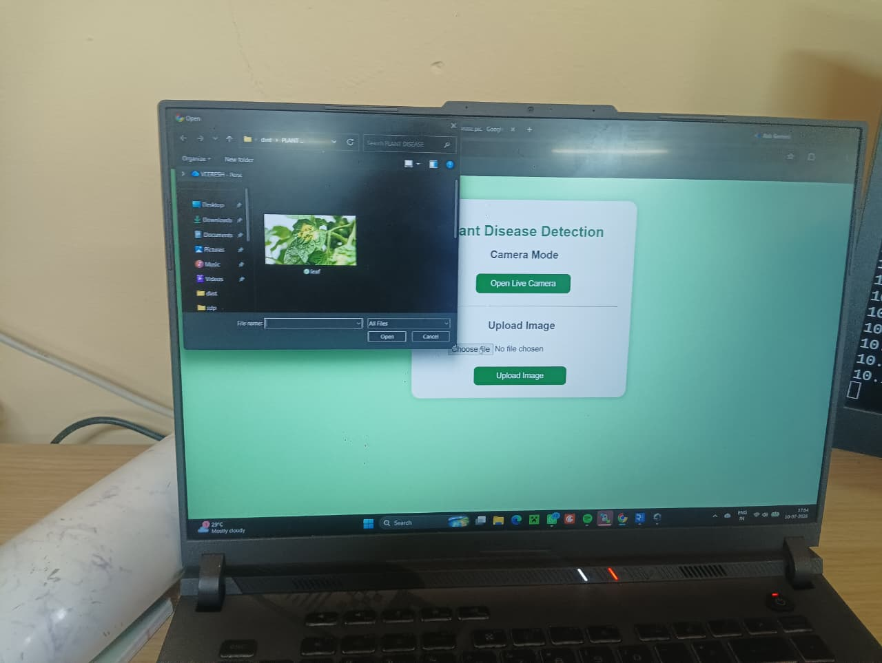
Implementation
The system is implemented using Raspberry Pi and Flask
Features
✔ Live camera detection
✔ Image upload detection
✔ AI-based disease classification
✔ OLED display output
✔ Disease confidence score
✔ User-friendly web interface

Slide 9
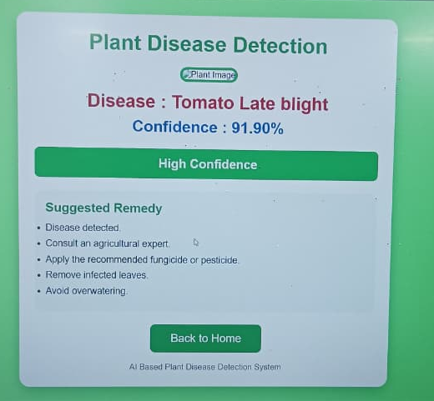
Results
Successfully detected plant diseases using both live camera and uploaded images

Slide 10
Conclusion & Future Scope
Conclusion
• Successfully developed an AI-based plant disease detection system.
• Integrated Raspberry Pi, Camera, OLED, and TensorFlow Lite.
• Supports both live camera and image upload.
• Provides quick and accurate disease prediction.
Future Scope
• Detect more crop diseases.
• Develop a mobile application.
• Add cloud database support.
• Integrate IoT for remote monitoring.
• Provide automatic fertilizer and pesticide recommendations.

